Slide 1
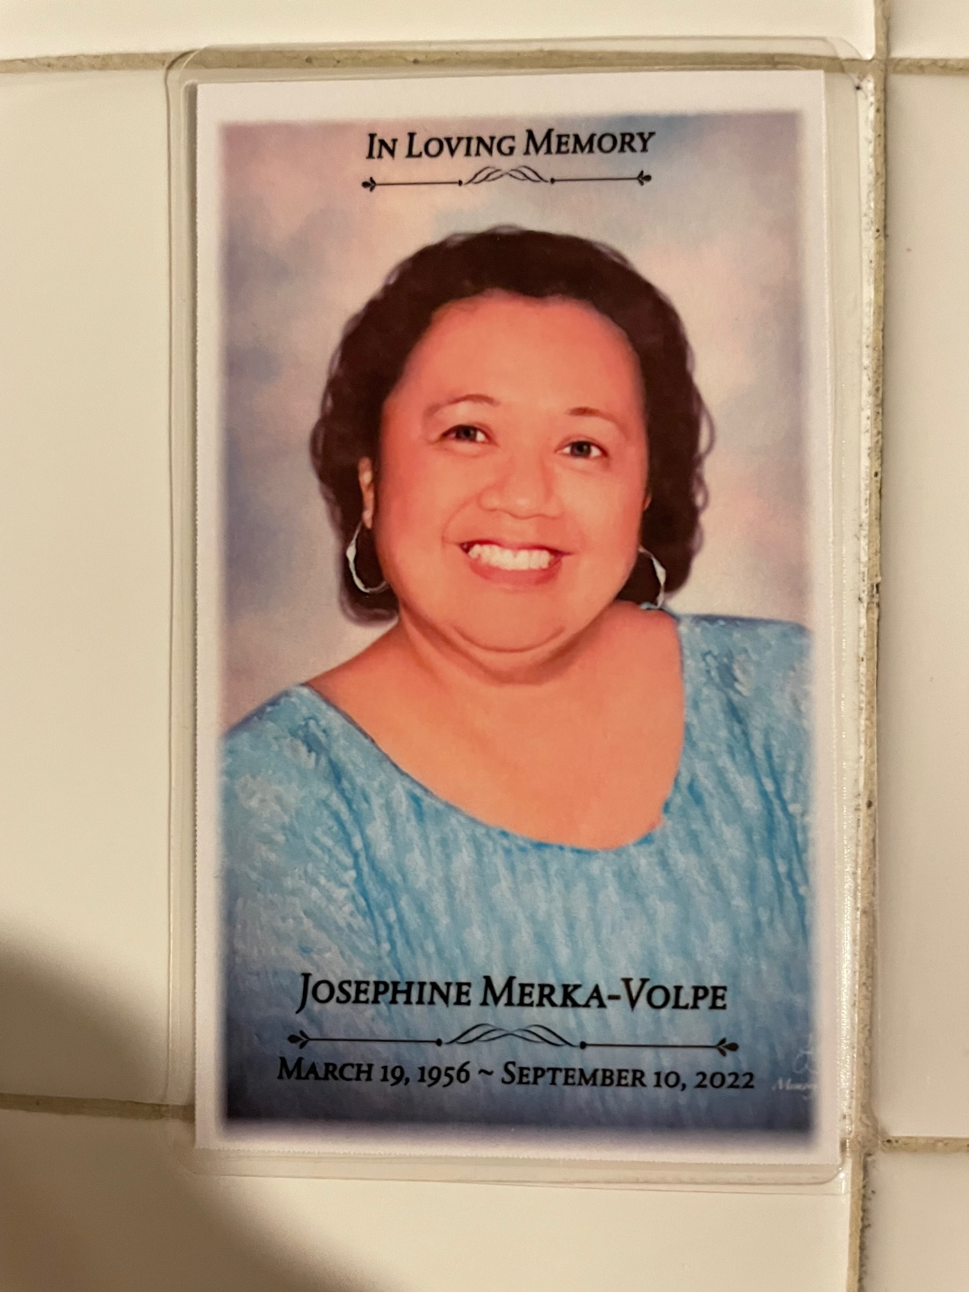
BLOODWORK MATTERS
QTPEN MEMORIAL SCHOLARSHIP PROGRAM

Slide 2
BLOODWORK MATTERS
I hope everyone appreciates the play on words.
The importance of the work of the clinical laboratory scientist; and, the testing performed and results for diagnostic and treatment purposes, can not be overstated.
This IL non-profit public charity organization is formed in memory of a career Medical Technologist who loved her profession; who took any and every opportunity to tell all who would listen about the critical role the lab and its people play in healthcare; and, how it shaped her life professionally and personally.
It is IRS approved tax exempt under 501(c)(3) IRS code, and therefore all donations are tax deductible

Slide 3
Mission & Vision
To promote and support the importance of the profession and the professional through financial, informational and human resource for entry and advancement in the field.
To be a viable presence and partner among the various organizations that promote and support medical technologists and medical laboratory; work tirelessly to bring about awareness and participation in the career paths and opportunities within the medical clinical laboratory; and conduct events and activities solely and in tandem with other organizations with similar purpose to support the mission vision and goals that raise awareness and funds

Slide 4
Goals
Tuition assistance through the QTPen Memorial Scholarship Program for new and current students
Financial assistance for Board certification(s)
Free and low-cost CE offerings
Educational and Informational resource
Career Opportunities resource
Professional Communications outlet
ASCP and ASCLS affiliation, sponsorship and participation

Slide 5
Her Passion and Career
Josephine was the consummate medical technologist. A career that spanned 45 years beginning with the WHO as a laboratory supervisor for establishing local and regional labs throughout Plateau State Nigeria and ending as Transfusion Security Officer for the Valley Health system in Las Vegas NV. She retired July 2021.
She prided herself as a Generalist (MT ASCP); performing and excelling in all divisions of the laboratory. Intrigued and fascinated by Blood Banking/Transfusion Services, she challenged herself to attain her BB(ASCP) and focused the last 15 years of her work in that arena.
She “loved the bench” but also was an accomplished manager and supervisor
Her faith, her family, her friends and her profession. The most important things to her; her profession likely number 2 on the list….and yes she had the greatest sense of humor.

Slide 6
QTPen Memorial Scholarship Program
Funds will be raised for annual awarding of tuition assistance to worthy students.
As many awards of $250 (and one $500) through available funding will be given on March 19th of each calendar year.
Recipients will be selected by committee through an application process that assesses: 1) character, 2) community engagement, 3) academics and 4) need
The program will focus on support of the Filipino-American student matriculating in community college and regionally accredited university based undergraduate medical technology/clinical laboratory science programs

Slide 7
Bloodwork Matters Contact Information
Mailing Address:
Bloodwork Matters
13467 S Mulberry St
Plainfield IL 60544
For Donations, please make out check to: Bloodwork Matters
The organization’s EIN : 92-0797617
All donations are tax deductible
You will receive receipt for your donation.
Executive Director: Mark Volpe
Phone: 779 248 2860
Email Address: msvolpe@bloodworkmatters.org

Slide 8
Fund Raising
Goal is to secure and maintain a minimum of $1000 annually so that awards are granted without interruption on an annual basis
The scholarship program will always grant two $250 and one $500
tuition assistance awards March 19th of each calendar year.
Award amounts as well as number of awards will increase with increased funding
Funding is also required so to support the additional financial support and professional resource activities of Bloodwork Matters

Slide 9
THANK YOU
PAMET NV, IN and MidWest chapters and PAMET USA Inc hold a special place in the heart of Josephine; as does the Philippine Nursing Association and its leadership and members.
Thank you for your anticipated support in co-sponsorship of events supporting the activities and purpose of Bloodwork Matters, and, in the selection process for those receiving tuition assistance awards.

